Slide 1


AI-Powered Fraud Detection in Auto Insurance

Slide 2

CONTENTS
1. Contributors
2. Introduction
3. Objective
4. Model Building
5. Model Evaluation
6. Feature Importance
7. Data Training
8. Data Pre-Processing
9. Data Testing

Slide 3

Contributors
1
Debasish Swain (22CSE944)
2
Krushna Chandra Barik (22CSE795)
3
Ayush Pattnaik (22CSE826)
4
Ankit Palo (22CSE1011)

Slide 4

02
Introduction

Slide 5




Introduction
Rising Fraud Challenges
AI as a Game-Changer
Smarter Claims Management
Future-Ready Solution
• Auto insurance fraud, like staged accidents and inflated claims, costs billions annually, driving up premiums.
• Advanced AI technologies enable real-time detection and prevention of fraudulent claims with unmatched accuracy.
• AI streamlines processes, reduces manual reviews, and ensures faster, fairer outcomes for legitimate claims.
• Scalable AI systems adapt to evolving fraud tactics, enhancing efficiency and customer trust.

Slide 6

03
Objective

Slide 7

Objective
1
Improve Detection Precision
2
Optimize Claims Processing
• Utilize AI to accurately identify and flag fraudulent claims, reducing errors and ensuring reliable outcomes.
• Automate manual tasks to expedite claim resolutions, enhancing efficiency and lowering operational expenses.
3
Adapt to Emerging Risks
4
Enhance Customer Satisfaction
• Implement scalable AI solutions that evolve with new fraud trends, maintaining robust protection over time.
• Deliver swift, fair claims handling for legitimate policyholders, fostering trust and loyalty.

Slide 8
04
Data Pre-Processing

Slide 9
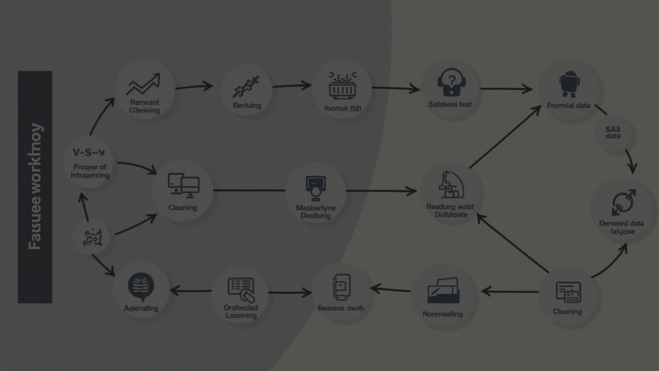

Data Pre-Processing
Data Cleaning
Data Transformation
• Remove duplicate claims and impute missing claim amounts with medians. Fix inconsistencies like mismatched vehicle or date details.
• Standardize claim amounts using Z-score normalization. Encode claim types (e.g., collision) with one-hot encoding.
Feature Engineering
Data Balancing
• Create features like claim frequency or suspicious pattern flags. Process claim narratives with NLP for fraud signals.
• Use SMOTE to oversample rare fraud cases. Balance dataset to avoid bias in predictions.

Slide 10

05
Model Building

Slide 11


Model Building
1
2
3
4
Model Selection
Feature Selection
Model Training
Model Evaluation
• Choose algorithms like Random Forest, XGBoost, or neural networks for fraud detection. Select based on ability to handle imbalanced data and feature importance.
• Use techniques like recursive feature elimination or SHAP values to pick key features. Reduce noise for better model performance.
• Train models on balanced, pre-processed data using cross-validation to optimize hyperparameters. Employ metrics like precision, recall, and F1-score to evaluate fraud detection.
• Test models on a hold-out dataset to assess performance against fraud cases. Use ROC-AUC and confusion matrices to ensure robust fraud identification.

Slide 12

06
Model Evaluation

Slide 13
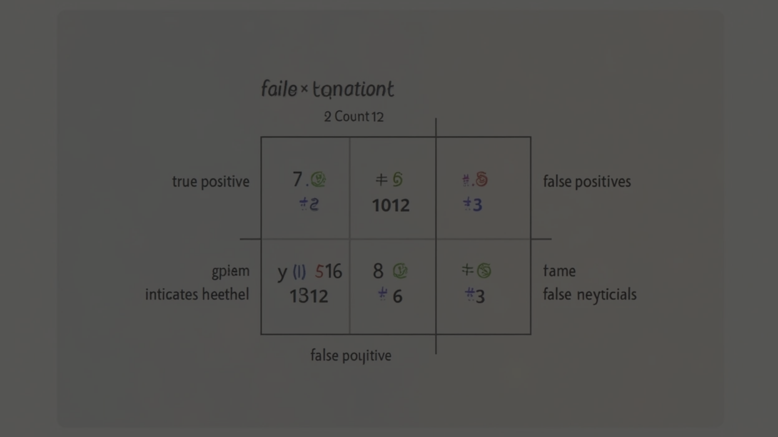
Model Evaluation
1
Performance Metrics
2
ROC-AUC Analysis
• Use precision, recall, and F1-score to evaluate fraud detection accuracy. Prioritize recall to minimize missed fraudulent claims.
• Calculate ROC-AUC to assess model ability to distinguish fraud from non-fraud. Ensure high AUC for robust classification.
3
Confusion Matrix
4
Cross-Validation
• Analyze true positives, false positives, and false negatives in test data. Identify misclassifications to refine fraud detection.
• Perform k-fold cross-validation to ensure consistent performance across data splits. Validate model stability on unseen insurance claims.

Slide 14

07
Feature Importance

Slide 15




Feature Importance
Feature Ranking
Model-Specific Insights
Correlation Analysis
Validation
• Use methods like SHAP or permutation importance to rank features. Identify top contributors like claim frequency or discrepancy flags.
• Test model performance after dropping low-importance features. Ensure key features like policyholder history enhance fraud prediction.
• For tree-based models (e.g., XGBoost), extract feature importance scores. Highlight features like claim amount or time-to-claim.
• Assess feature correlations to avoid redundancy in fraud detection. Remove highly correlated features to improve model efficiency.

Slide 16

09
Data Testing

Slide 17
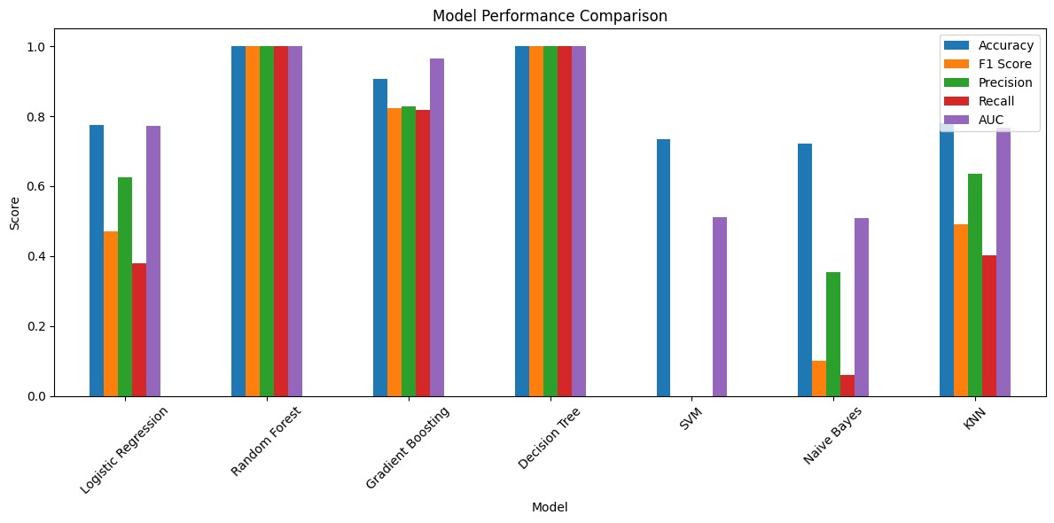
Data Testing

Slide 18
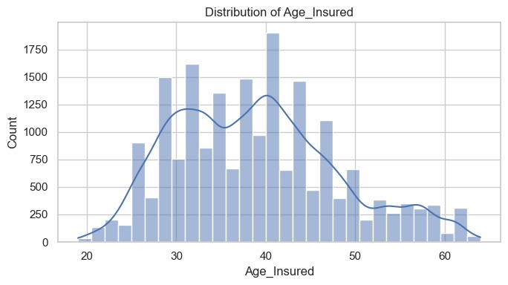
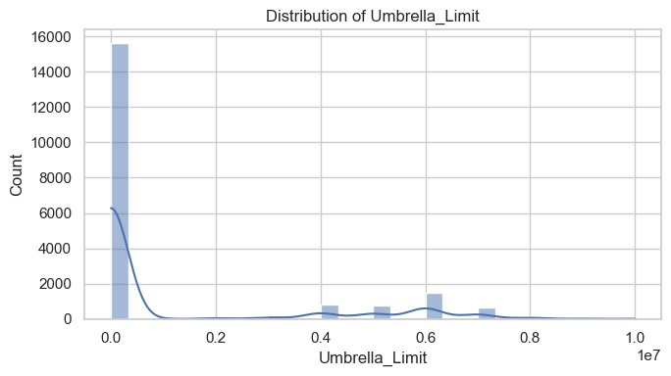
Data Visualization

Slide 19
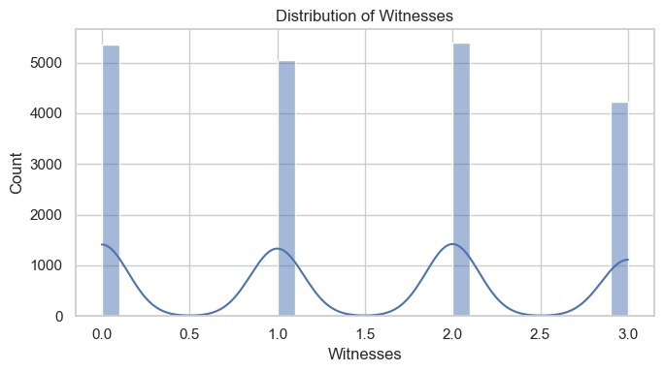
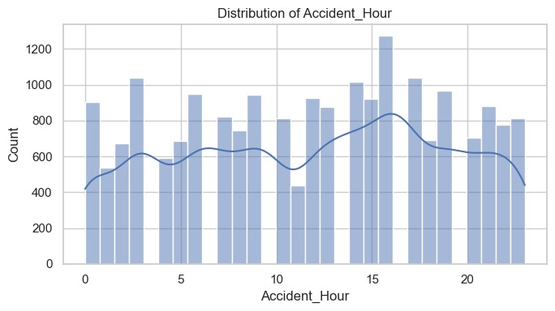
Data Visualization

Slide 20
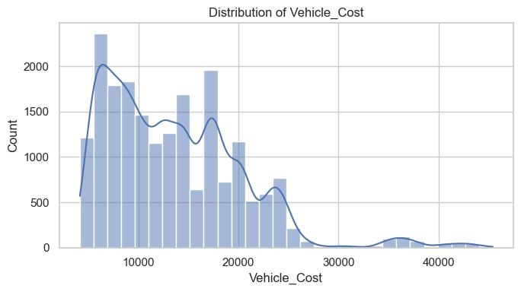
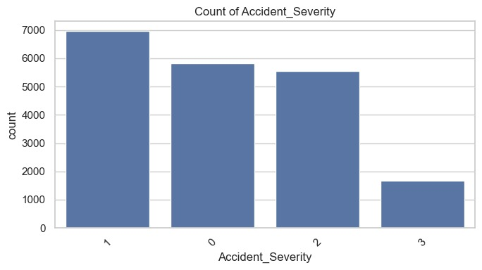
Data Visualization

Slide 21
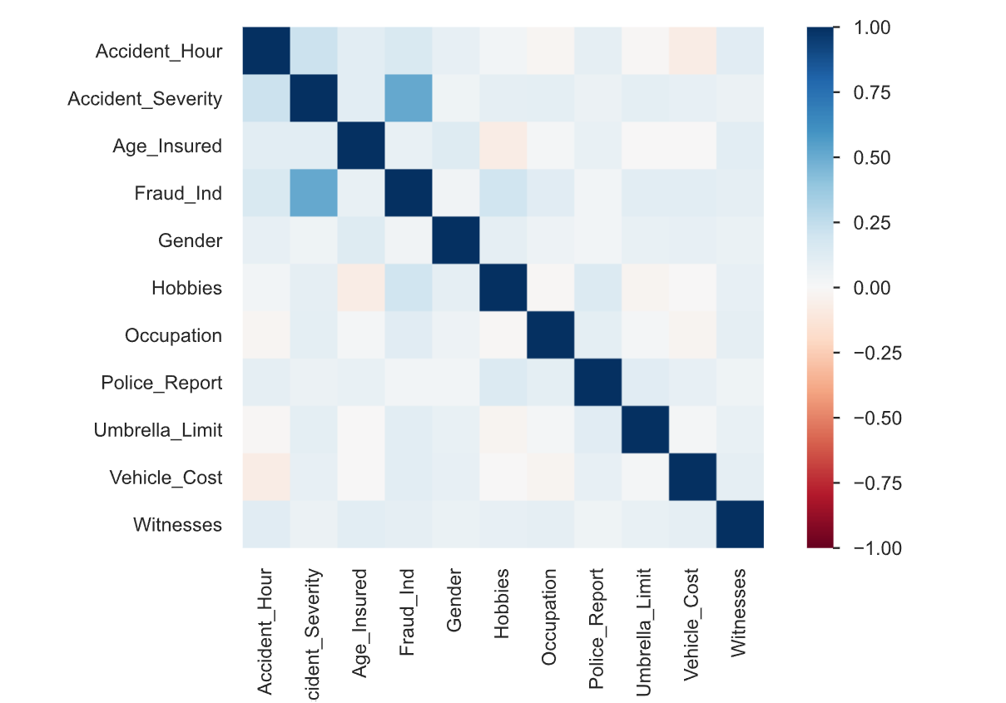
Correlations between the data set

Slide 22
Thank You

